Slide 1
How to sub-class SKSpriteNode
and use SKSpriteNode(imageNamed)
Notes:
It seems quite a lot of people (myself) included have started learning Swift by also learning/writing usually a game that use SpriteKit.
Why sub-class? Apple suggest it, common OO approach. I suggest there are (at least) two ways you’d like to sub-class. Firstly to implement a specific type of node or secondly a more generic category. First, let’s look at the simple classic usage.

Slide 2
Simple usage
Simple non sub-classed usage
Notes:
This is a convenience initializer which is extremely convenient. In a lot of the examples and tutorials on the Internet this seems to be the most used initializer. It’s surprisingly hard to use it from an interesting sub-class! Initially this seemed to be because Apple hadn’t either formalized the rules for Initializers or at least implement them. I think the latter. The problem was that if you called a convenience initalizer in the superclass when it called either another convenience initializer or the designated one if made it as a virtual class first which meant if you didn’t provide a subclass implementation it crashed.

Slide 3
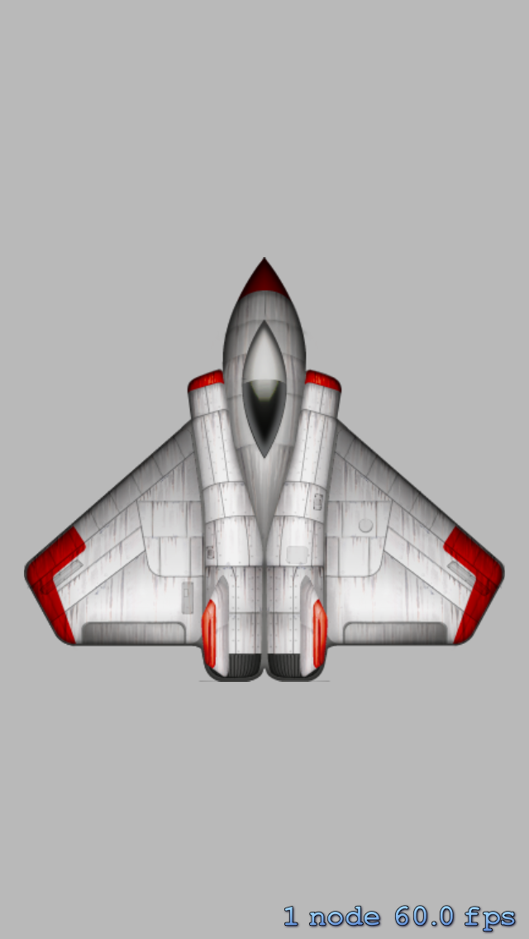

Slide 4
What is was like in beta 2
TODO: Example from blog
Old blog post about it

Slide 5
Full sub-class: the ideal
class SpaceshipIdeal : SKSpriteNode
{
// Other properties & methods ...
required init(coder aDecoder: NSCoder!)
{
super.init(coder: aDecoder)
}
override init()
{
super.init(imageNamed: "Spaceship")
}
}
! Must call designated initializer of superclass ‘SKSpriteNode’
Notes:
Swift only permits sub-class initializers to cross call to designated or convenience initilizers within the same class and then designated initializers to their superclass parent.

Slide 6
Full sub-class: reality
class Spaceship : SKSpriteNode
{
// Other properties & methods ...
required init(coder aDecoder: NSCoder!)
{
super.init(coder: aDecoder)
}
override init()
{
let color = UIColor()
let texture = SKTexture(imageNamed: "Spaceship")
let size = texture.size()
super.init(texture: texture, color: color, size: size)
}
}
Notes:
The best we can do is re-implement the imageNamed functionality. Thanks to SO for this.
You also probably noticed the use of init(code) method to. The rules say only need to provide if superclass (or protocol) has a required method. The Swift wrapper for SKSpriteNode doesn’t have one but we’re still forced too.

Slide 7
General sub-class
class CustomSpriteNode : SKSpriteNode
{
// Properties that can be handled by a generated initializer
let value = 0
var value1 : Int?
}
Notes:
The thing to note here is that this class has additional properties and that that either they all have initial values or that they can be default initialized, i.e. optionals. In this case a default initiializer is generated and all the designated and convenience initializers are inherited.
Therefore we can use this one just like the superclass!
NOTE: No init(aCoder)
But,

Slide 8
General with init
class CustomSpriteNodeWithInitializer : SKSpriteNode {
// Properties that can be handled by a generated initializer
let value = 0
var value1 : Int?
let myName: String!
required init(coder aDecoder: NSCoder!) {
super.init(coder: aDecoder)
}
init(myName: String, imageNamed imageName: String) {
self.myName = myName
let color = UIColor()
let texture = SKTexture(imageNamed: imageName)
let size = texture.size()
super.init(texture: texture, color: color, size: size)
}
}
Notes:
More than likely the simple case of relying upon the default initializer will be insufficient as the construction of your sub-class needs to be parameritzed. In this case it’s really just the full sub-class approach again.

Slide 9



The End
petebarber.blogspot.com
@foobarber
github.com/petebarber/Misc/tree/master/HowToSubClassSKSpriteNode

